Slide 1
Strengthening Emergency Response through SBCC:
New Directions and Opportunities
Rafael Obregon, Chief, Communication for Development Section
UNICEF, NY

Slide 2
Outline
SBCC in the Global Humanitarian Architecture
UNICEF’s SBCC engagement in Public Health Emergencies
Lessons Learned
Strategic Directions and Investments

Slide 3
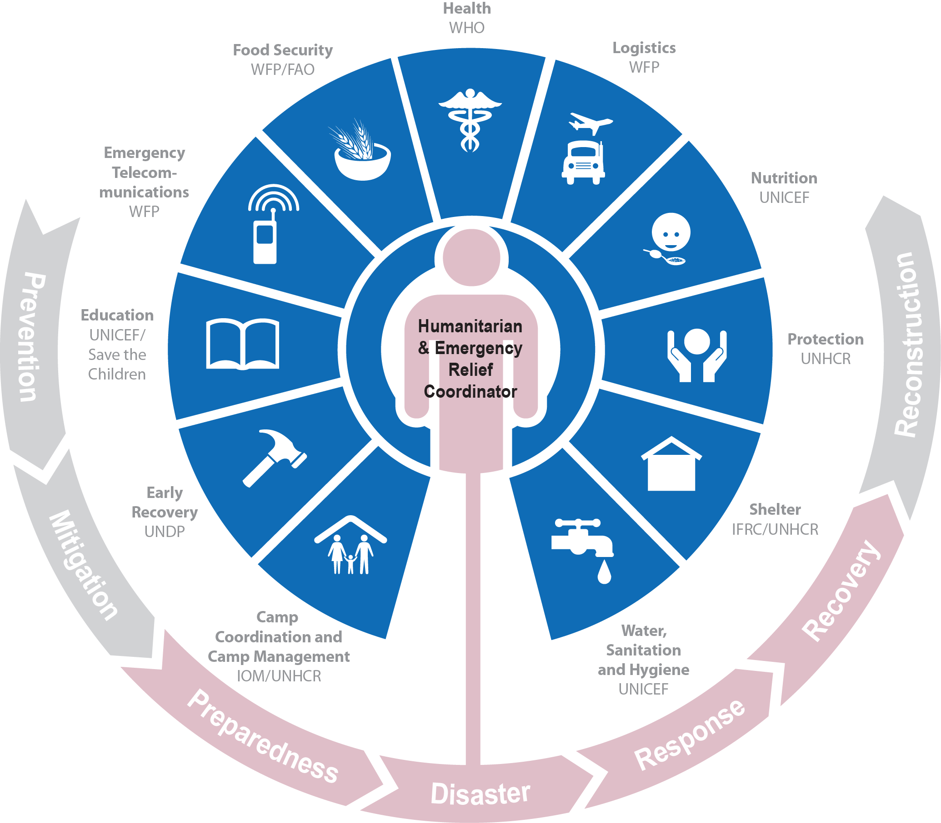
Humanitarian Reform and the Cluster approach
Predictable leadership and provider of last resort.
Ensuring timely and effective responses
Strengthening partnerships
Improved strategic field-level coordination and prioritization, leading to fewer gaps and duplication.
NUTRITION CLUSTER | WASH CLUSTER | EDUCATION CLUSTER | CHILD PROTECTION AOR | GENDER BASED VIOLENCE AOR
Notes:
Please note: The IFRC is as “Cluster Convener” is not accountable o the UN and not a provider of last resort, because of the independence of the Red Cross Red Crescent Movement. We will talk about this more, later in the presentation.

Slide 4
UNICEF’s SBCC Engagement in Public Health Emergency Response
Coordination Social Mobilization Pillar
Co-lead Social Mobilization Pillar with MOH (e.g. Sierra Leone - Over 35 partners / Average 16 in each district; linkages to national Ebola response center; Standard Operating Procedures).
Latin America (USAID-supported SBCC work in four countries))
Technical Support to Govt/CSO Partners on SBCC Implementation
National campaigns; community engagement; capacity building (e.g. West Africa; Brazil)
Leveraging of community-based platforms (e.g village committees in Guinea, FBOs)
Evidence-based SBCC
RapidPro platforms (u-Report in Sierra Leone; Liberia); KAP Studies (Ebola; Zika)
Rapid Polling (e.g. trust in polio eradication efforts in Nigeria, Pakistan, Afghanistan)
Digital Listening Tool in Zika outbreak to track rumors, information seeking.
Cross-Sectoral Linkages
SBCC support to other areas (e.g. back to school, child protection in West Africa)
SBCC in support of Care and support to families affected by Zika - microcephaly

Slide 5
Post 2015 Ebola Outbreaks: Lessons and Implications
Lessons Learned
Coordination – duplication due to lack of SOPs; multiple messaging
Technical Response – Slow application of SBCC principles (e.g. listening)
Local Capacity – Strengthening of local networks, community-based organizations
Data and Evidence – Better systems and use of data to feedback into response
Preparedness – Proactive focus; ready-to-activate systems (national social mobilization pillars pillars)
Implications for UNICEF
Strengthen institutionalization and core SBCC capacity
Shape the global humanitarian architecture, including public health emergencies
Global partnerships and platforms for rapid, predictable, more effective support
Strengthen development – humanitarian nexus – increasing focus on engagement in urbanized contexts

Slide 6
Are we better prepared for the next emergency?
Humanitarian Architecture (Common Services Platform)
Coordinated with Clusters/IASC
UN agencies/ INGOs/Networks
Social Sciences/Anthropology Research Platform
Boost the evidence-based
Pre-position data on a range of contextual, cultural and communication aspects
Surge Capacity Mechanism
Regional hubs and country specific capacity and partners for mobilization
Developed globally with partners
Outbreak Communication Capacity
Internal to UNICEF through academic partnerships
Expand through regional partnerships
Notes:
Coordination mechanism
Social Sciences/Anthropology Research Platform
Surge Capacity Mechanism with Regional/Country Capacity on Communication/C4D in Humanitarian Action
Outbreak Communication Capacity – internal and external focused

Slide 7
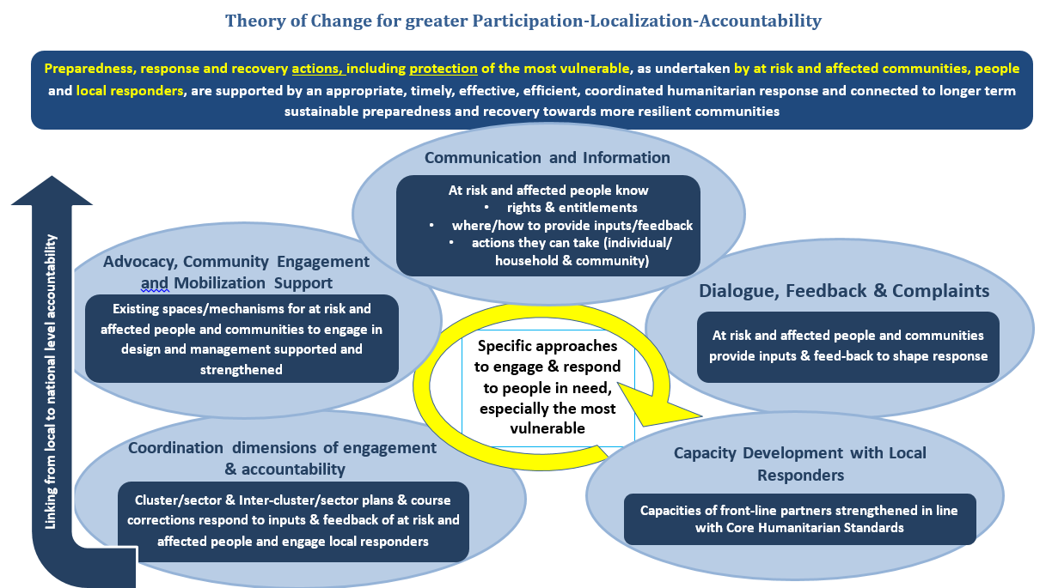
Positioning SBCC in the Humanitarian Architecture

Slide 8
Are we better prepared, for the next emergency?
Humanitarian Architecture (Common Services Platform)
Coordinated with Clusters/IASC
UN agencies/ INGOs/Networks
Social Sciences/Anthropology Research Platform
Boost the evidence-based
Pre-position data on a range of contextual, cultural and communication aspects
Surge Capacity Mechanism
Regional hubs and country specific capacity and partners for mobilization
Developed globally with partners
Outbreak Communication Capacity
Internal to UNICEF through academic partnerships
Expand through regional partnerships
Notes:
Coordination mechanism
Social Sciences/Anthropology Research Platform
Surge Capacity Mechanism with Regional/Country Capacity on Communication/C4D in Humanitarian Action
Outbreak Communication Capacity – internal and external focused

Slide 9
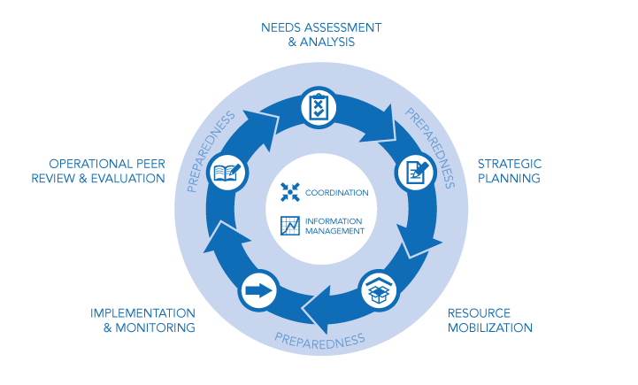
Inter Cluster Coordination
Questions?
Inter-cluster coordination is the mechanism through which clusters come together at national and sub-national level to coordinate the response through each stage of the humanitarian programme cycle.

